Slide 1
Topic: Bivariate Data EQ: What is Correlation?

Slide 2
24
7
30
Date
Bivariate Data
EQ: What is correlation?
What is Correlation?
5

Slide 3
24
7
30
Date
Bivariate Data
EQ: What is correlation?
What is Correlation?
A correlation indicates a relationship between two variables
What are the types of relationships?
5

Slide 4
24
7
30
Date
Bivariate Data
EQ: What is correlation?
A correlation describes a relationship between two data sets. Scatter plots provide a convenient way to determine whether a ___________ exists between two variables.
What is Correlation?
correlation
What are the types of relationships?
positive
A __________ correlation occurs when both variables increase.
negative
A ___________ correlation occurs when one variable increases and the other variable decreases.
If the data points are randomly scattered there is _______ or no correlation.
little
5

Slide 5
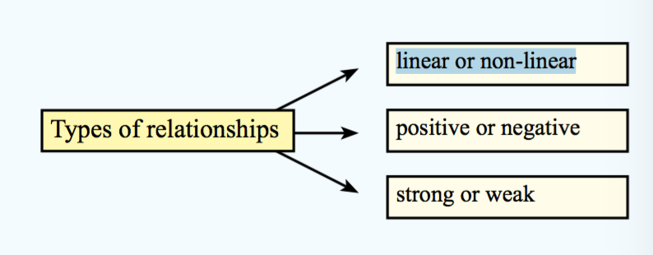
24
7
30
Date
Bivariate Data
EQ: What is correlation?
What is Correlation?
A correlation indicates a relationship between two variables
What are the types of relationships?
5

Slide 6
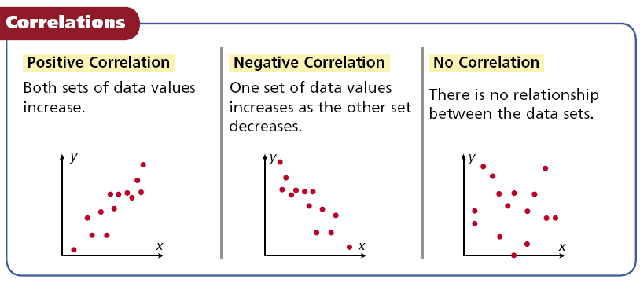
24
7
30
Date
Bivariate Data
EQ: What is correlation?
5

Slide 7
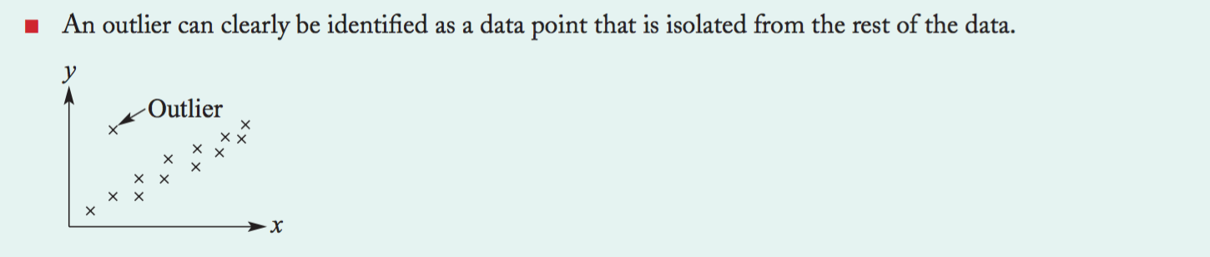
24
7
30
Date
Bivariate Data
EQ: What is correlation?
5

Slide 8
Positive correlation
Negative correlation
little or no correlation

Slide 9
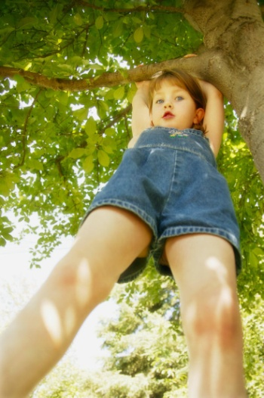
Positive Correlation
If you look at the age of a child and the child’s height, you will find that as the child gets older, the child gets taller. Because both are going up, it is positive correlation.
Age | 1 | 2 | 3 | 4 | 5 | 6 | 7 | 8
Height | 25 | 31 | 34 | 36 | 40 | 41 | 47 | 55

Slide 10

Negative Correlation
If you look at the age of your family’s car and its value, you will find as the car gets older, the car is worth less. This is negative correlation.
Age of car | 1 | 2 | 3 | 4 | 5
Value | $30,000 | $27,000 | $23,500 | $18,700 | $15,350

Slide 11
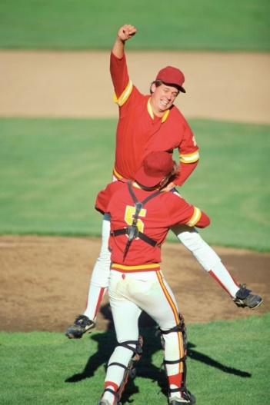
No Correlation
If you look at the size shoe a baseball player wears, and their batting average, you will find that the shoe size does not make the player better or worse, then are not related.

Slide 12
Example 1:
The scatter plots of data relate characteristics of children from
0 to 18 years old.
Match each scatter plot with the appropriate variables studied.
1. age and height
2. age and eye color
3. age and time needed to run a certain distance
no correlation between age and eye color
as your age increases your height also increases
2
1
as your age increases the time will decrease
3

Slide 13
If the data points are close to the line of best fit, it is said to have a ___________correlation.
strong
weak positive
strong positive
weak negative
strong negative

Slide 14
Notes Review
24, 7 ,30
Date
Title
Essential question
Notes complete
Notes complete with colour and diagrams
Questions completed
Contents page filed in
Formula page filled in

Slide 15
Homework
Review your notes and write a summary answering the essential question.

